Slide 1


FANTASTIC 5
Iteration 1
PRESENTATION
28 MAY, 2024

Slide 2
WELCOME
Content
OVERVIEW
SOFTWARE DESIGN
UI DESIGN
WIREFRAMES
Information regarding how we are going to proceed forward with our project
REQUIREMENTS
TESTING PLAN
28 MAY, 2024

Slide 3

FANTASTIC 5
Overview
In Iteration 1, our team has progressed to having a more fully formed plan and begun development work. The iteration began with refining our requirements based on meeting with the teams we are collaborating with. From there, we developed a software design document and created the initial structure of our project. Finally, we have begun developing our core features.

Slide 4

Introduction & Design Goals
Introduction
Project Portal Frontend UI
Built with React
Integrates with backend services by other teams
Focus on intuitive and user-friendly design
Design Goals
User-Friendliness: Intuitive navigation
Integration: Seamless backend integration
Performance: Fast loading and responsiveness
Scalability: Future expansion ready
Maintainability: Modular and clear code
28 MAY, 2024

Slide 5
Software Design
Software Architecture
Framework: React, component-based structure
Using modified MVC
Main Pages: Dashboard, Landing, Account Registration, Login, Project Page
Component Examples:
Dashboard: Search Bar, Cards, Modal Popup
Project Page: Add/Edit functionality, analytics, task management
Folder Structure:
/src
components: Header, Footer, NavigationBar, etc.
pages: Dashboard, LandingPage, ProjectPage, AccountRegistrationPage
assets: Images, styles
28 MAY, 2024

Slide 6
UI Design
Design Concept: Minimalism and user-friendliness
Inspiration: Apple's design ethos
Key Elements: Clean lines, subtle animations, calming color palette
Tools: Figma for layout and wireframes
28 MAY, 2024

Slide 7
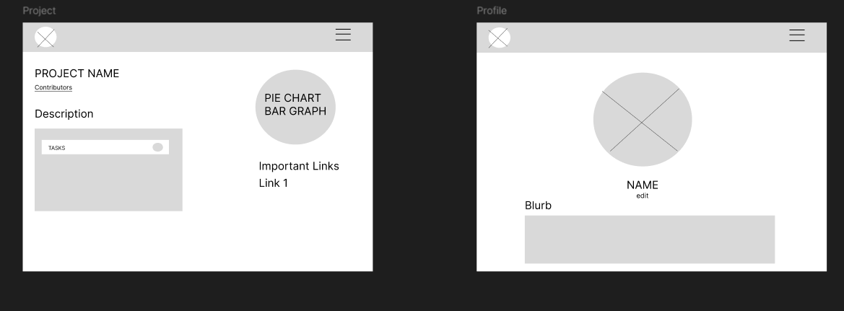
Wireframes
28 MAY, 2024

Slide 8
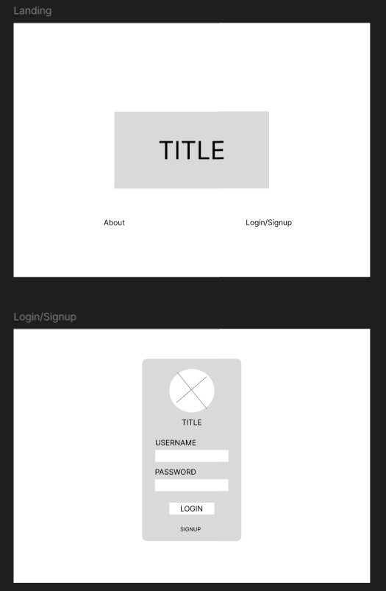
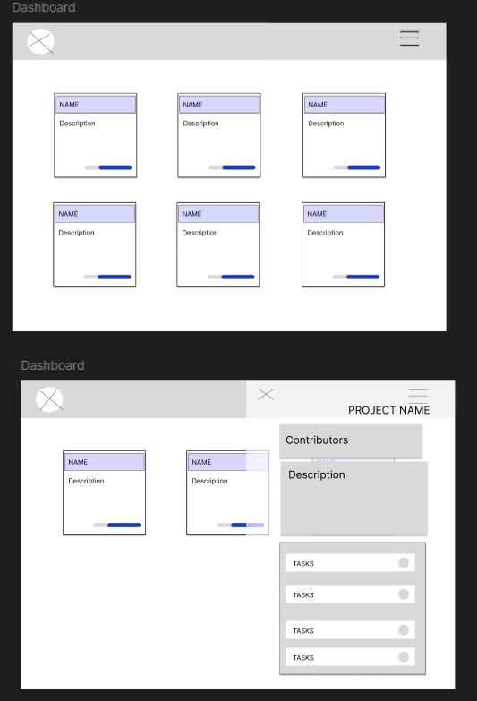
28 MAY, 2024

Slide 9
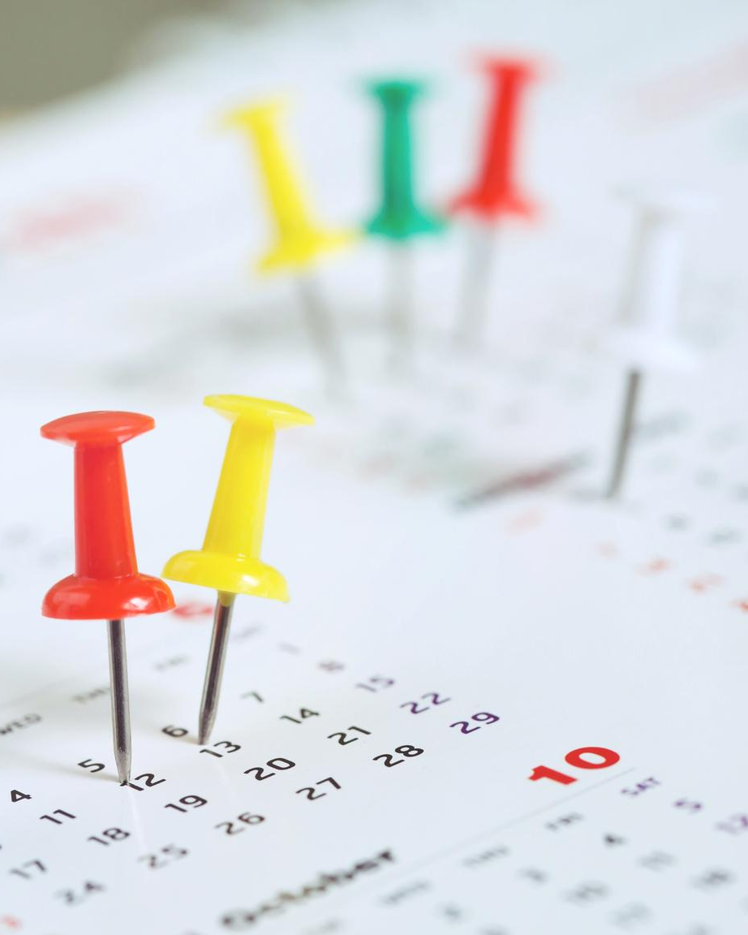
FANTASTIC 5
ITERATION | FUNCTIONAL REQ. | TASKS | ESTIMATED HOURS
1 | User Registration User Login Project Creation Project Editing | Primarily UI Development | 20 15 25 10
2 | Integrate UI from Iter1 with other teams’ services Task Assignment and Deadline Setting Team Roles and Permission Management | UI Development, Backend Integration, Testing | 15 15 30 25
3 | Project Search Project Analytics Update Notifications Deadline Notifications | UI Development, Backend Integration, Testing | 20 20 15 20
UPDATED TIMELINE
28 MAY, 2024

Slide 10
Testing Plan
Metrics
Defect Rate
Test Coverage
Coding Standards
Consistent Naming Conventions
Proper Commenting
Refactoring Code
Adherence to Best Practices
Code Review Process
Branch Naming Conventions
PR Creation and Review
Approval and Merge
Iteration Completion
28 MAY, 2024

Slide 11
Testing Plan
Testing
Test-Driven Development (TDD)
Unit Testing
Manual Testing (Gherkin Language)
Automation Testing (Selenium-Behave, Postman)
Defect Management
Logging Defects
Backlog Review
Fixing and Testing Defects
Verification and Closure
28 MAY, 2024

Slide 12
FANTASTIC 5
Thank You
Iteration 1
28 MAY, 2024

